Slide 1

TEAM 2A
Diabetes Prediction
Abhinav Samavedula, Chun Hui Tsai, Hilary Nguyen, Lalitha Bhupalam, Ruicheng Li
Notes:
Lalitha
Hello we are Team 2A. Today we’re here to talk about our machine learning project on Diabetes prediction.

Slide 2

Diabetes:
A chronic health condition that affects how your body turns food into energy. Most of the food you eat is broken down into sugar and released into your bloodstream.
Notes:
Diabetes is a chronic condition that changes your body’s sugar cycle. There are a lot of factors that affect diabetes and it poses significant risks of additional complications. It is increasing in numbers everyday.

Slide 3
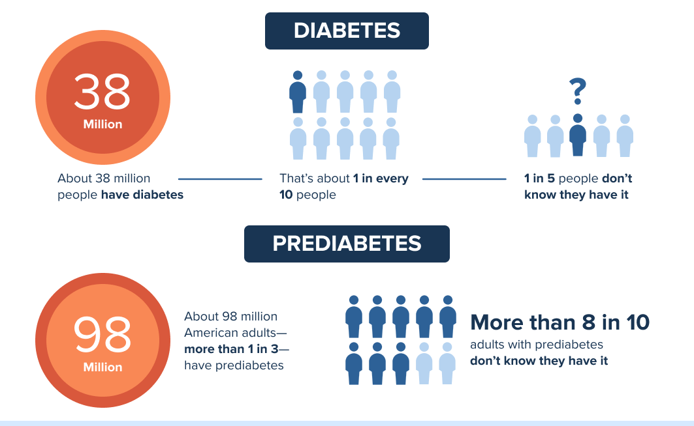
Statistics:USA
Notes:
Let’s look at the statistics for America. 38 million people 1 out of 10 people have diabetes and more than 8 in 10 people are pre-diabetic. So it is a widespread disease which has serious impact on lives of patients.

Slide 4

But why?

Slide 5


Patient Benefit
Health Provider Benefit
Notes:
Abhinav

Slide 6

Data source
Kaggle dataset : Diabetes prediction Dataset
Has data similar to what you find in a Healthcare institution.
Notes:
Abhinav

Slide 7

Data: Summary and Description
Demographic Data
Lifestyle Data
Age, Gender
BMI , Smoking History
Blood Glucose Data
Heart and BP history
HbA1c(Haemoglobin A1c level), Blood Glucose levels
Heart disease, Hypertension
Class (prediction)
Diabetes
*categorical/ numeric
Notes:
Abhinav

Slide 8
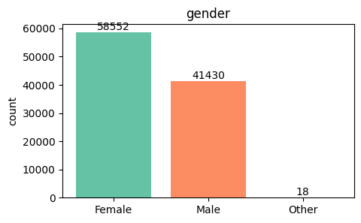
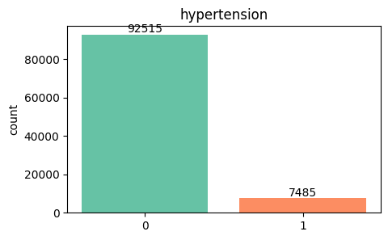
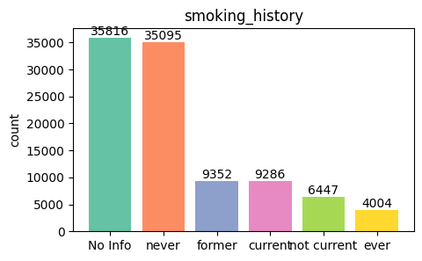
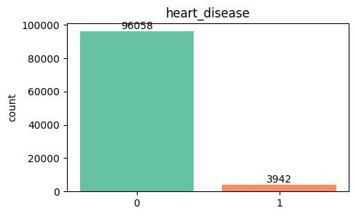
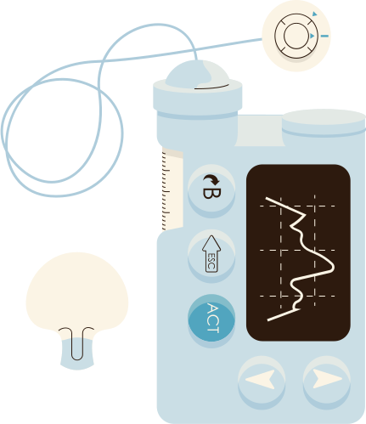
Data visualization (Univariate-categorical)
Notes:
mention there is 100,000 data, and no missing value
先提一下Smoking history value 的category看起來有些重疊，為後面data transformation做鋪成

Slide 9
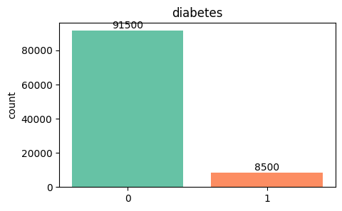
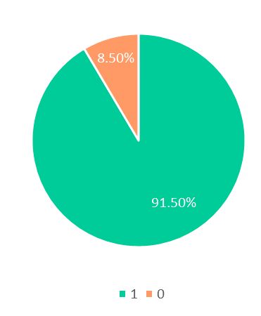
Data visualization (Univariate-categorical)
Notes:
*mention how imbalance the class is (with percentage )

Slide 10
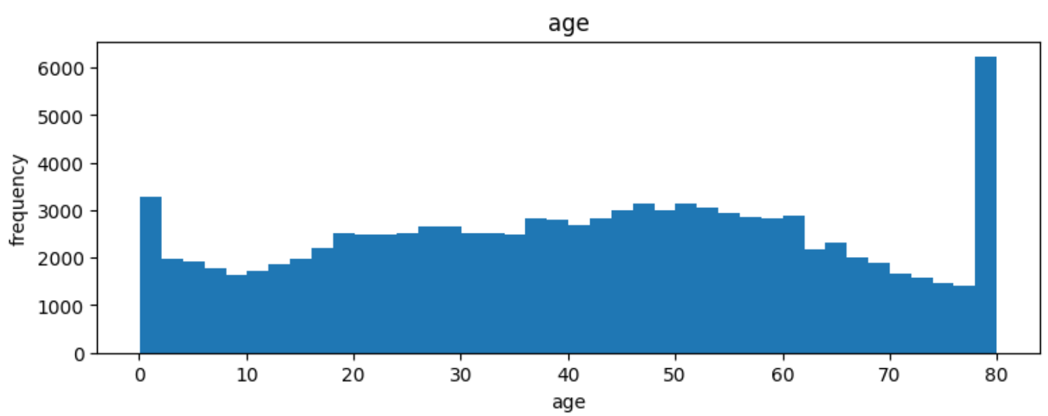
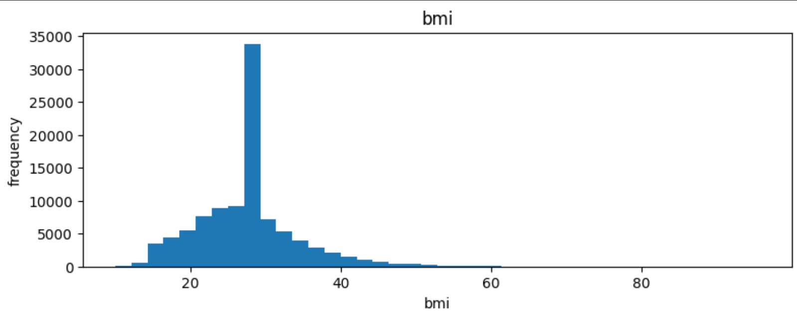
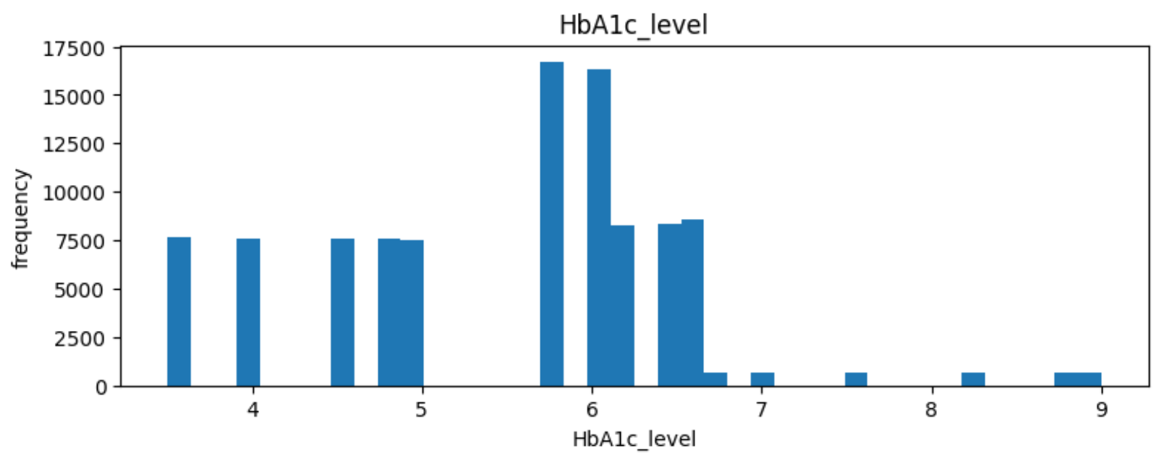
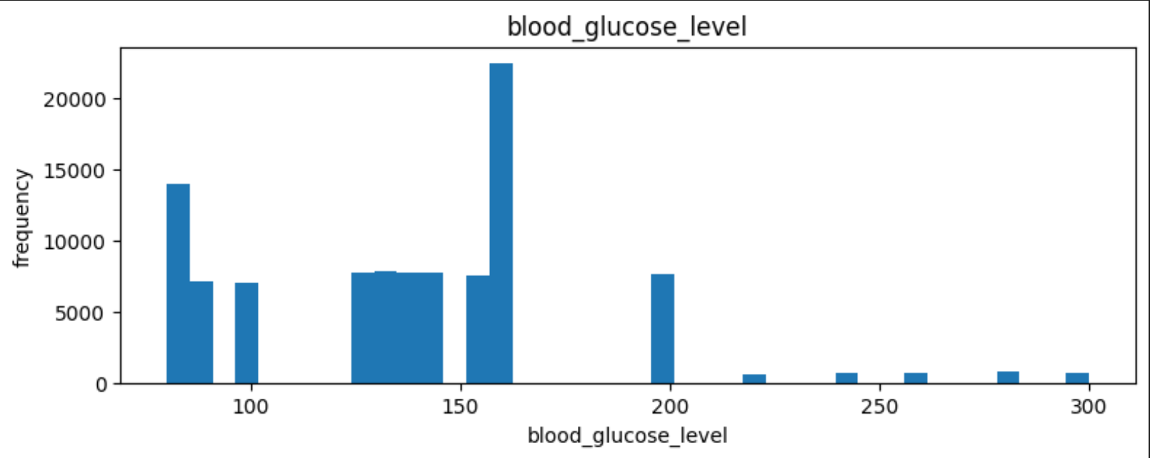
Data visualization (Univariate-numerical)

Slide 11
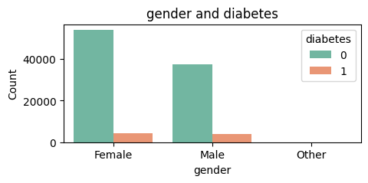
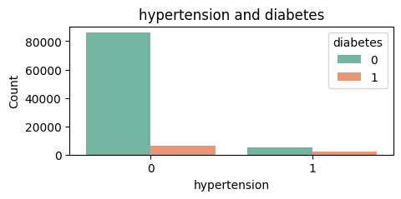
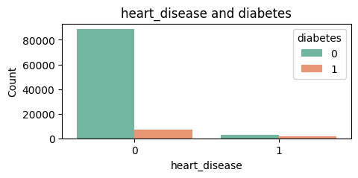
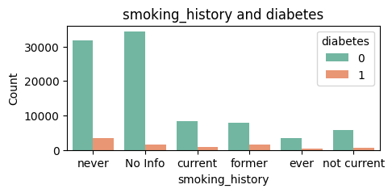
Data visualization (multivariate-categorical)

Slide 12
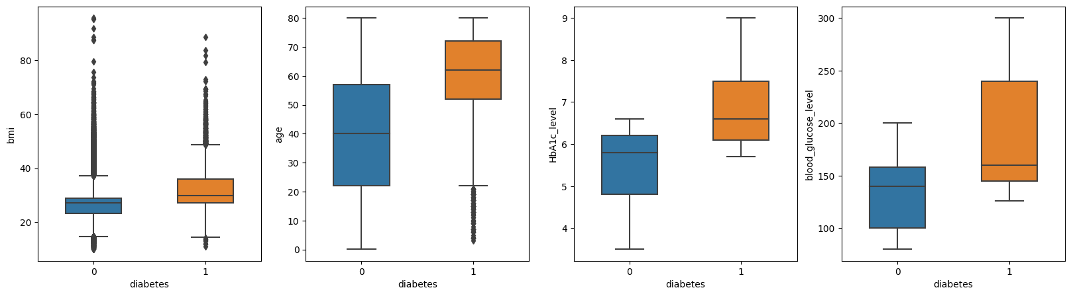
Data visualization (multivariate-numerical)

Slide 13
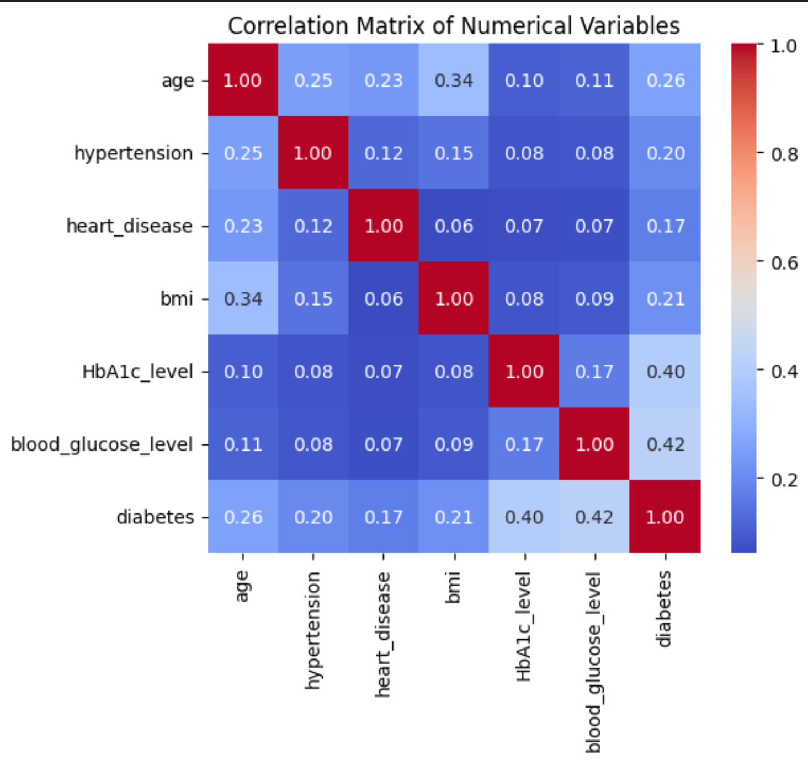
Data visualization (Correlation Matrix)

Slide 14
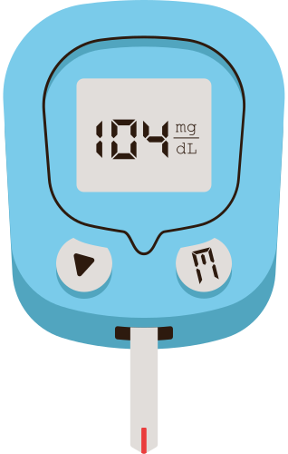
Models
Logistic Regression: suitable for large datasets
Decision Tree: robust to different types of variables, can capture complex, non-linear patterns in the data
Random Forest: less prone to overfitting
Notes:
* since we have a large dataset,
Logistic Regression is a relatively simple and computationally efficient algorithm, making it suitable for large datasets or scenarios where computational resources are limited,
Trees are fairly robust to: types of variables (numeric/continuous, categorical), how many are irrelevant, etc.
Random forest: provide high accuracy and generalization performance across a variety of datasets. By aggregating predictions from multiple trees, Random Forest reduces both variance and bias. This ensemble approach tends to produce more stable and reliable predictions.

Slide 15
Logistic Regression

Slide 16


Preprocessing Steps
Step 1:
Encoding categorical-> numerical

Slide 17
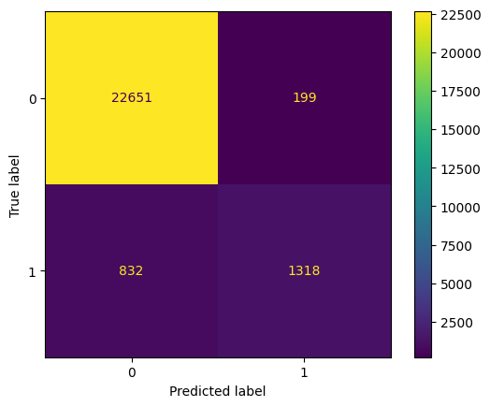
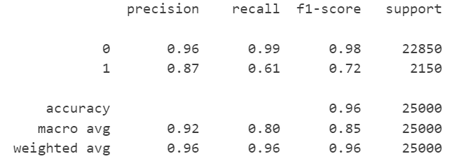
Train test split: 75%, 25%
LogisticRegression(random_state=42, solver='newton-cholesky')
Train accuracy score: 0.96103
Test accuracy score: 0.95876
Notes:
*reason why we look at recall rate instead of overall accuracy: 希望能準確預測到實際上患有糖尿病的人

Slide 18
Preprocessing Steps
Step 1:
Encoding categorical-> numerical
Drop ‘gender’=’Other’
Transformation in ‘smoking_history’ column
'not_current' -> 'former'
'ever' -> 'current'
Get dummies for ‘smoking_history’ column
Standardize numeric data
['age', 'bmi', 'HbA1c_level', 'blood_glucose_level']

Slide 19
Preprocessing Steps
Step 2: Resampling
Undersampling-RandomUnderSampler
Oversampling-RandomOverSampler
Step 3: Hyperparameter selection
GridSearchCV

Slide 20
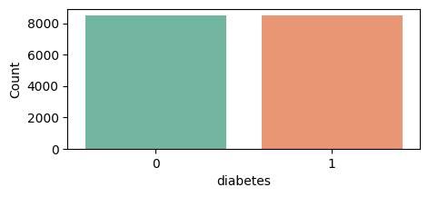
Resampling
Undersampling-RandomUnderSampler

Slide 21
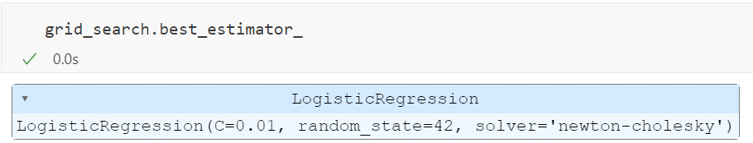
Hyperparameter selection
GridSearchCV
Notes:
Logistic Regression is a relatively simple and computationally efficient algorithm, making it suitable for large datasets or scenarios where computational resources are limited.

Slide 22
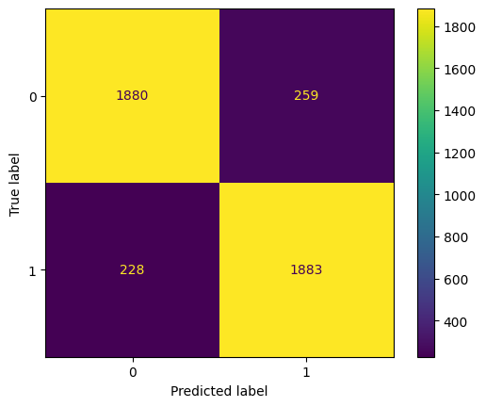
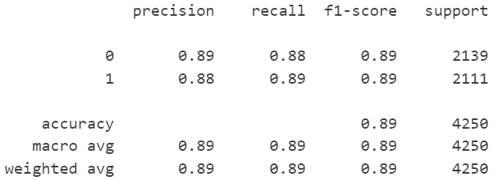
Train test split: 75%, 25%
Train accuracy score: 0.88471
Test accuracy score: 0.88541
Notes:
*雖然overall accuracy比還沒processing來的低，但recall rate提升了(0.61->0.89)，預測class 1的準確度提升，是我們樂見的

Slide 23
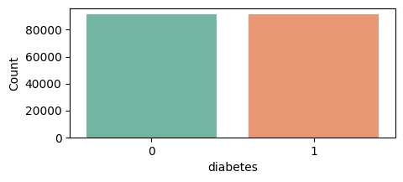
Resampling
Oversampling-RandomOverSampler

Slide 24
Hyperparameter selection
GridSearchCV
Notes:
Logistic Regression is a relatively simple and computationally efficient algorithm, making it suitable for large datasets or scenarios where computational resources are limited.

Slide 25
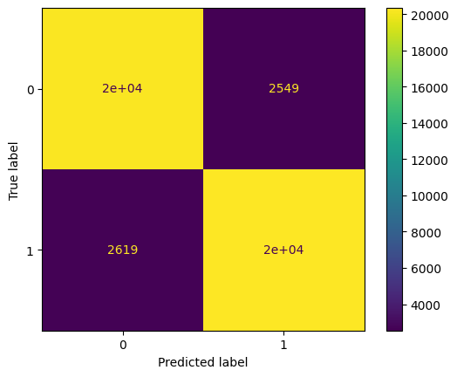
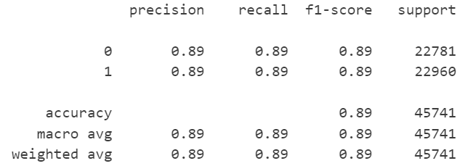
Train test split: 75%, 25%
Train accuracy score: 0.88458
Test accuracy score: 0.88702
Notes:
*提這邊oversampling的數字跟undersampling沒什麼差別，所以這些數字是我們最終跑logistic的結果

Slide 26
Decision Tree
Notes:
To search for better result, we test Decision Tree for potential improvements

Slide 27
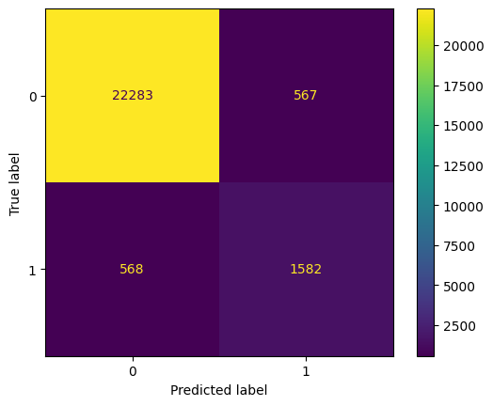
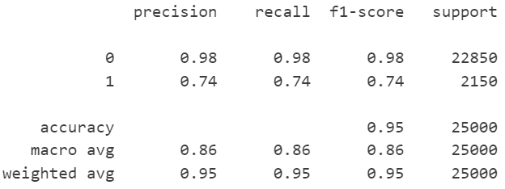
Train test split: 75%, 25%
Train accuracy score: 0.99932
Test accuracy score: 0.95476
Notes:
Before data preprocessing, it demonstrated notably improved data quality overall, but there’s 26% of true positive not being indentified, (which in healthcare, can have severe consequences)

Slide 28
Preprocessing Steps
Step 1:
Drop ‘gender’=’other’
Transformation in ‘smoking_history’ column
'not_current' -> 'former'
'ever' -> 'current'
Step 2: Resampling
Undersampling-RandomUnderSampler
Oversampling-RandomOverSampler
Step 3: Hyperparameter selection
pruning
Notes:
to increase the recall rate, we conduct similar data engineering techniques as what we have done for Logistic regression

Slide 29
Resampling
Undersampling-RandomUnderSampler
Notes:
First, undersampling

Slide 30
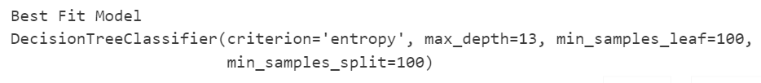
Hyperparameter selection
Pre-pruning using GridSearchCV
Notes:
and pre-pruning our tree using GridSearchCV to get best fit model that has max_depth equals 13

Slide 31
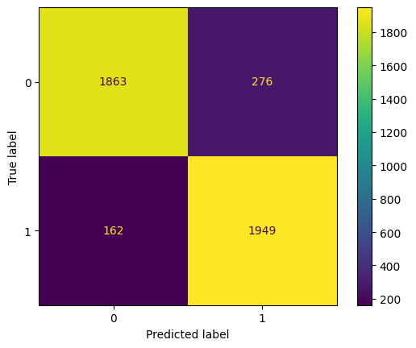
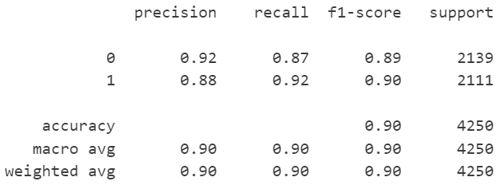
Train test split: 75%, 25%
Train accuracy score: 0.90729
Test accuracy score: 0.89694
Notes:
This is the result. while the overall accuracy reduces, the recall rate has notably improved to 92%, surpassing logistic regression's performance.

Slide 32
Resampling
Oversampling-RandomOverSampler
Notes:
What about the result after oversampling?

Slide 33

Hyperparameter selection
Pre-pruning using GridSearchCV
Notes:
and pre-pruning?

Slide 34
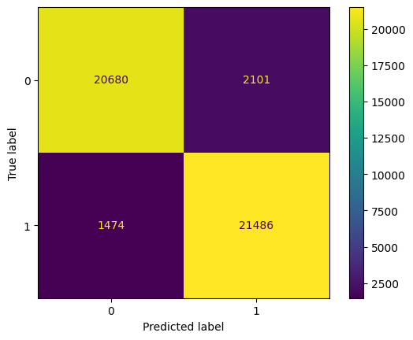
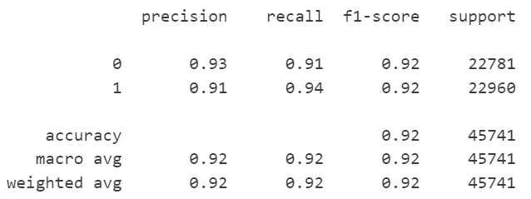
Train test split: 75%, 25%
Train accuracy score: 0.92865
Test accuracy score: 0.92184
Notes:
The outcome is even better with higher overall accuracy and recall score.

Slide 35
Random Forest
Notes:
Considering this, we wonder how much better our predictions could get with a random forest.

Slide 36
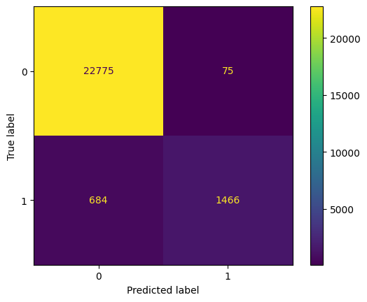
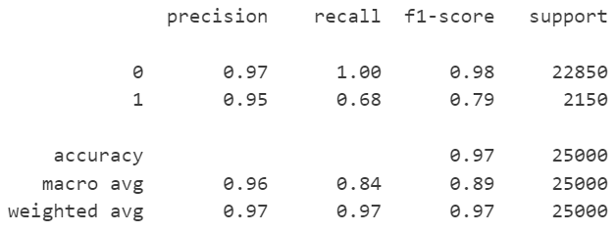
Train test split: 75%, 25%
RandomForestClassifier(n_estimators = 100, criterion='entropy', random_state=42)
Train accuracy score: 0.99932
Test accuracy score: 0.96964
Notes:
Without data preprocessing, we obtain very high accuracy scores but low ability in classifying positive instances.

Slide 37
Preprocessing Steps
Step 1:
Drop ‘gender’=’other’
Transformation in ‘smoking_history’ column
'not_current' -> 'former'
'ever' -> 'current'
Step 2: Resampling
Oversampling-RandomOverSampler
Notes:
So again, we oversample class 0 data

Slide 38
Resampling
Oversampling-RandomOverSampler
Notes:
making both class balanced

Slide 39
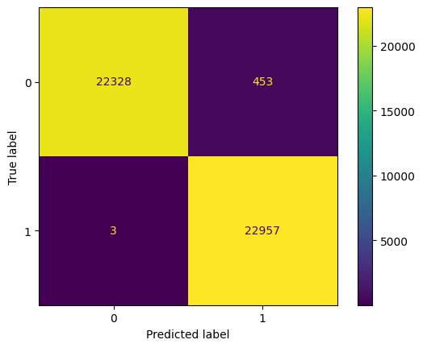
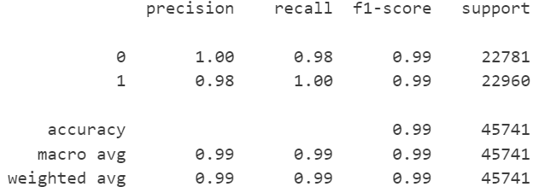
Train test split: 75%, 25%
RandomForestClassifier(n_estimators = 100, criterion='entropy', random_state=42)
Train accuracy score: 0.99923
Test accuracy score: 0.99003
Notes:
The outcome is exceptionally remarkable, with overall and prediction accuracy for actual diabetes patients reaching nearly 100%, which couldn’t be higher!

Slide 40
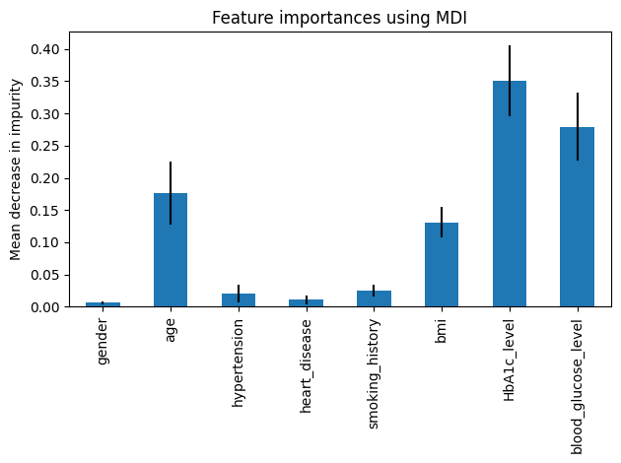
Notes:
And the feature: HbA1c_level, blood_glucose, and age are the very key contributors to this promising outcome, as we can also infer from the heatmap we had presented.

Slide 41
Takeaways & Recommendation
Method 1
Method 2
Method 3
Decision Tree: Good, but not best
Without Preprocessing
Recall: 0.74
Preprocessing: UnderSampling
Recall: 0.92
Preprocessing: OverSampling
Recall: 0.94
Logistic Regression Model: Not best
Without Preprocessing
Recall: 0.61
Preprocessing: OverSampling
Recall: 0.89
Not suitable for our dataset
Random Forest: Best
Without Preprocessing:
Recall: 0.68
Preprocessing: OverSampling
Recall: 1.0
Most accurate overall

Slide 42

Thank you!
1:1

